Slide 1
Transformers
Bryan Pardo
Deep Learning
Northwestern University

Slide 2
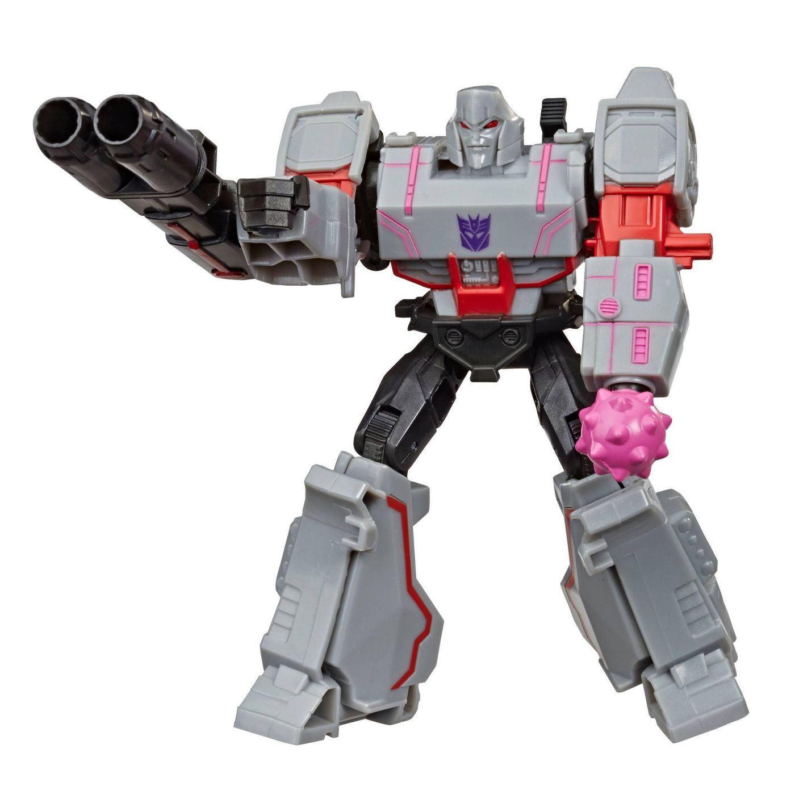
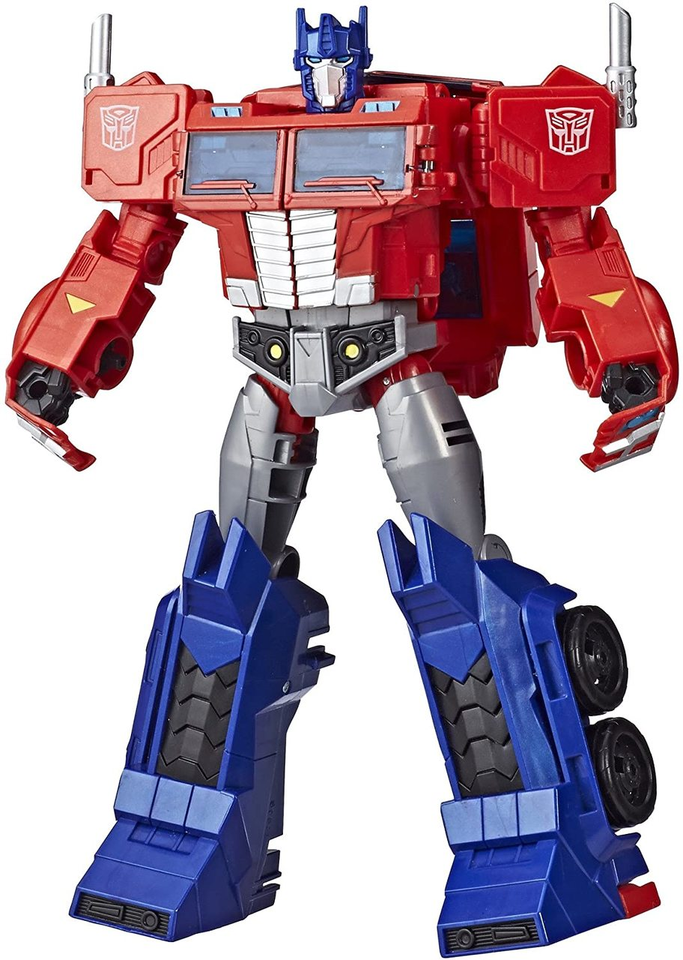
We’re ready for Transformers!

Slide 3
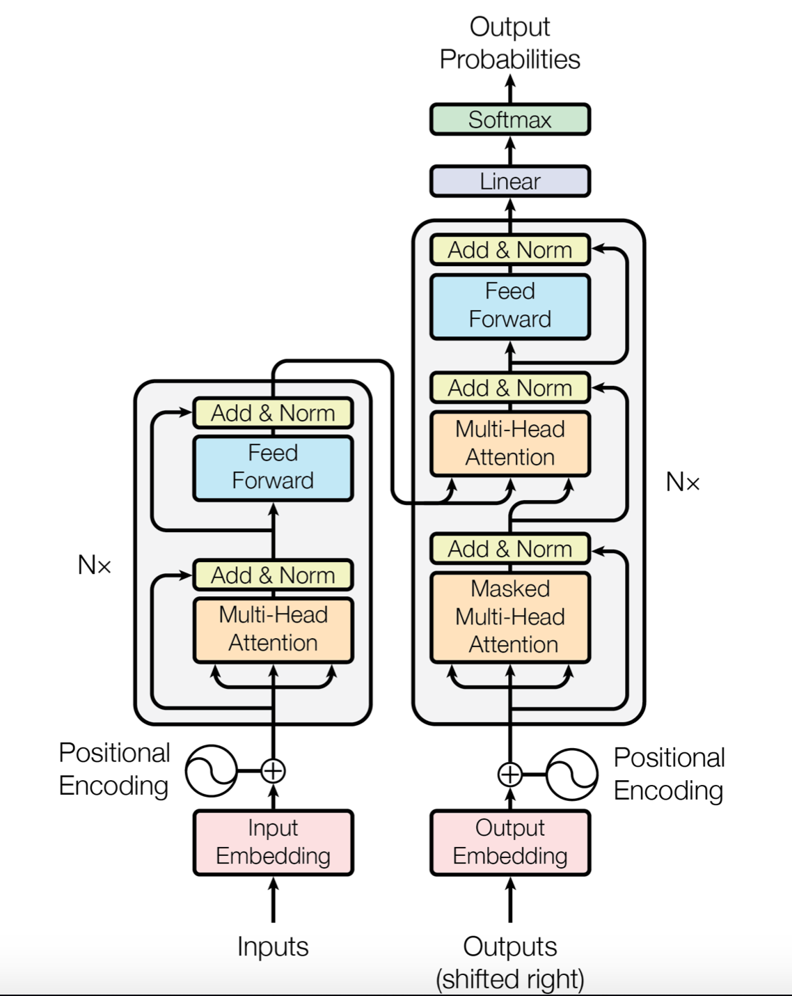
Pay Attention!
Transformers introduced in 2017
Use attention
Do NOT use recurrent layers
Do NOT use convolutional layers
..Hence the title of the paper that introduced them
Vaswani, A., Shazeer, N., Parmar, N., Uszkoreit, J., Jones, L., Gomez, A. N., ... & Polosukhin, I. (2017). Attention is all you need. In Advances in neural information processing systems(pp. 5998-6008).

Slide 4
Features of Transformers
They use residual connections to allow deeper networks to fine-tune as appropriate
They use attention in multiple places in both the encoder and decoder
People often mistake them for automobiles

Slide 5
Step-by-step

Slide 6
The Input sequence
Let’s build a representation that takes the input sequence and learns relationships between input tokens (words represented by their embeddings)
Embedding: 0 734 912 733 43 1
Input sentence: [START] Thinking machines think quickly [STOP]

Slide 7
Positional encoding
In an RNN, the recurrence encodes the order implicitly.
In a Transformer, relatedness between words is handled by self-attention.
If we’re not using recursion to implicitly encode order, how does the system tell the difference between these two sentences?
Bob hands Maria the ball.
Maria hands Bob the ball.

Slide 8
Positional encoding
Lots of ways to go
e.g. just number the items.
They chose to implicitly encode position by adding the values of a bunch of sinewaves to the embeddings
Honestly, I’m not sure why they did it this way, rather than just appending an index number to the embedding

Slide 9
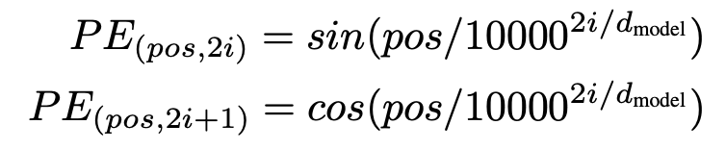

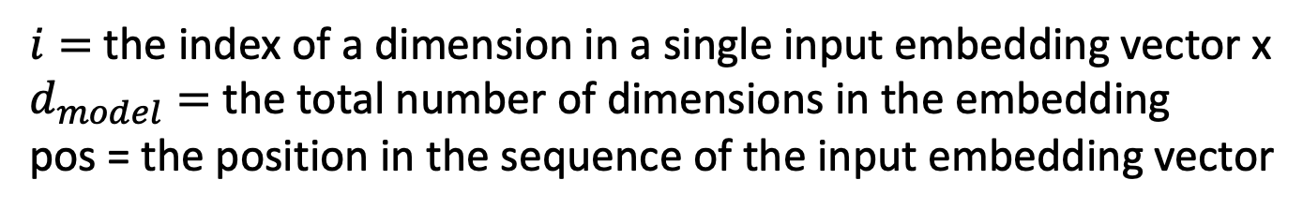
Positional encoding
$i=$ the index of a dimension in a single input embedding vector x
$d_{model}=$ the total number of dimensions in the embedding
pos = the position in the sequence of the input embedding vector

Slide 10
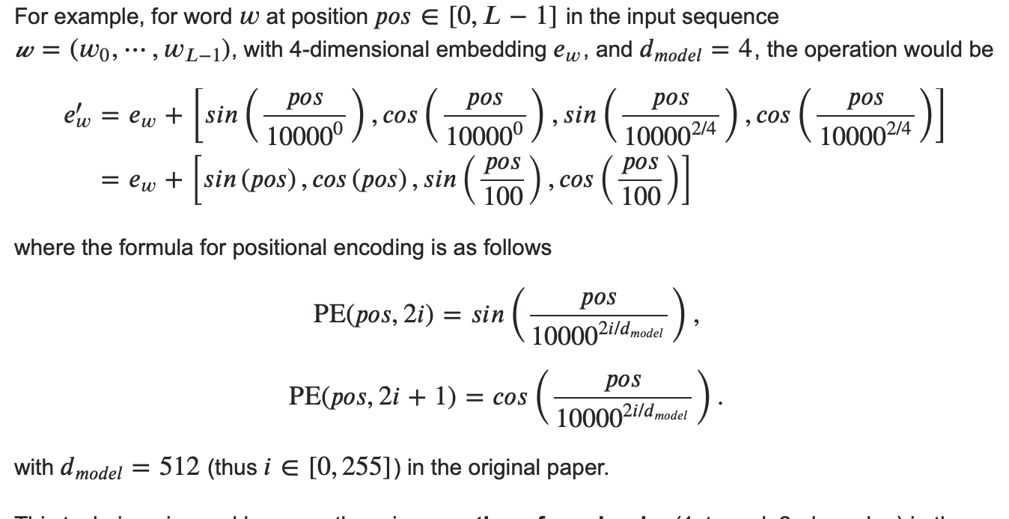
A concrete example
Thanks for the example, anonymous contributor on Stack Overflow!
https://datascience.stackexchange.com/questions/51065/what-is-the-positional-encoding-in-the-transformer-model

Slide 11
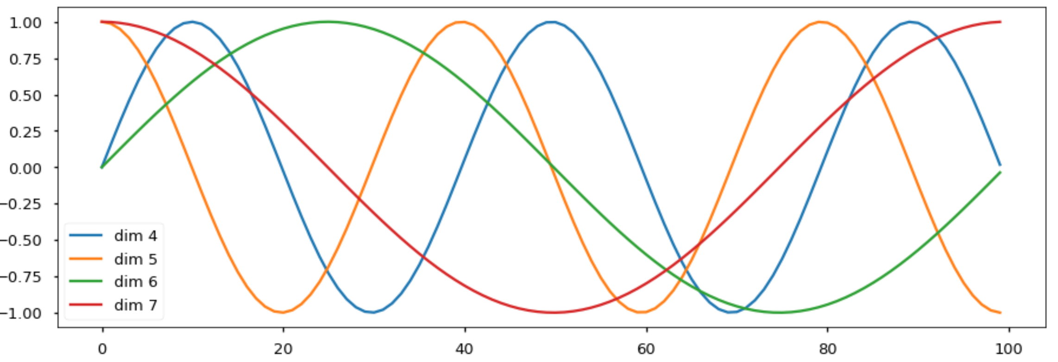
Some positional encodings visualized
https://nlp.seas.harvard.edu/2018/04/03/attention.html#decoder

Slide 12
Step-by-step

Slide 13
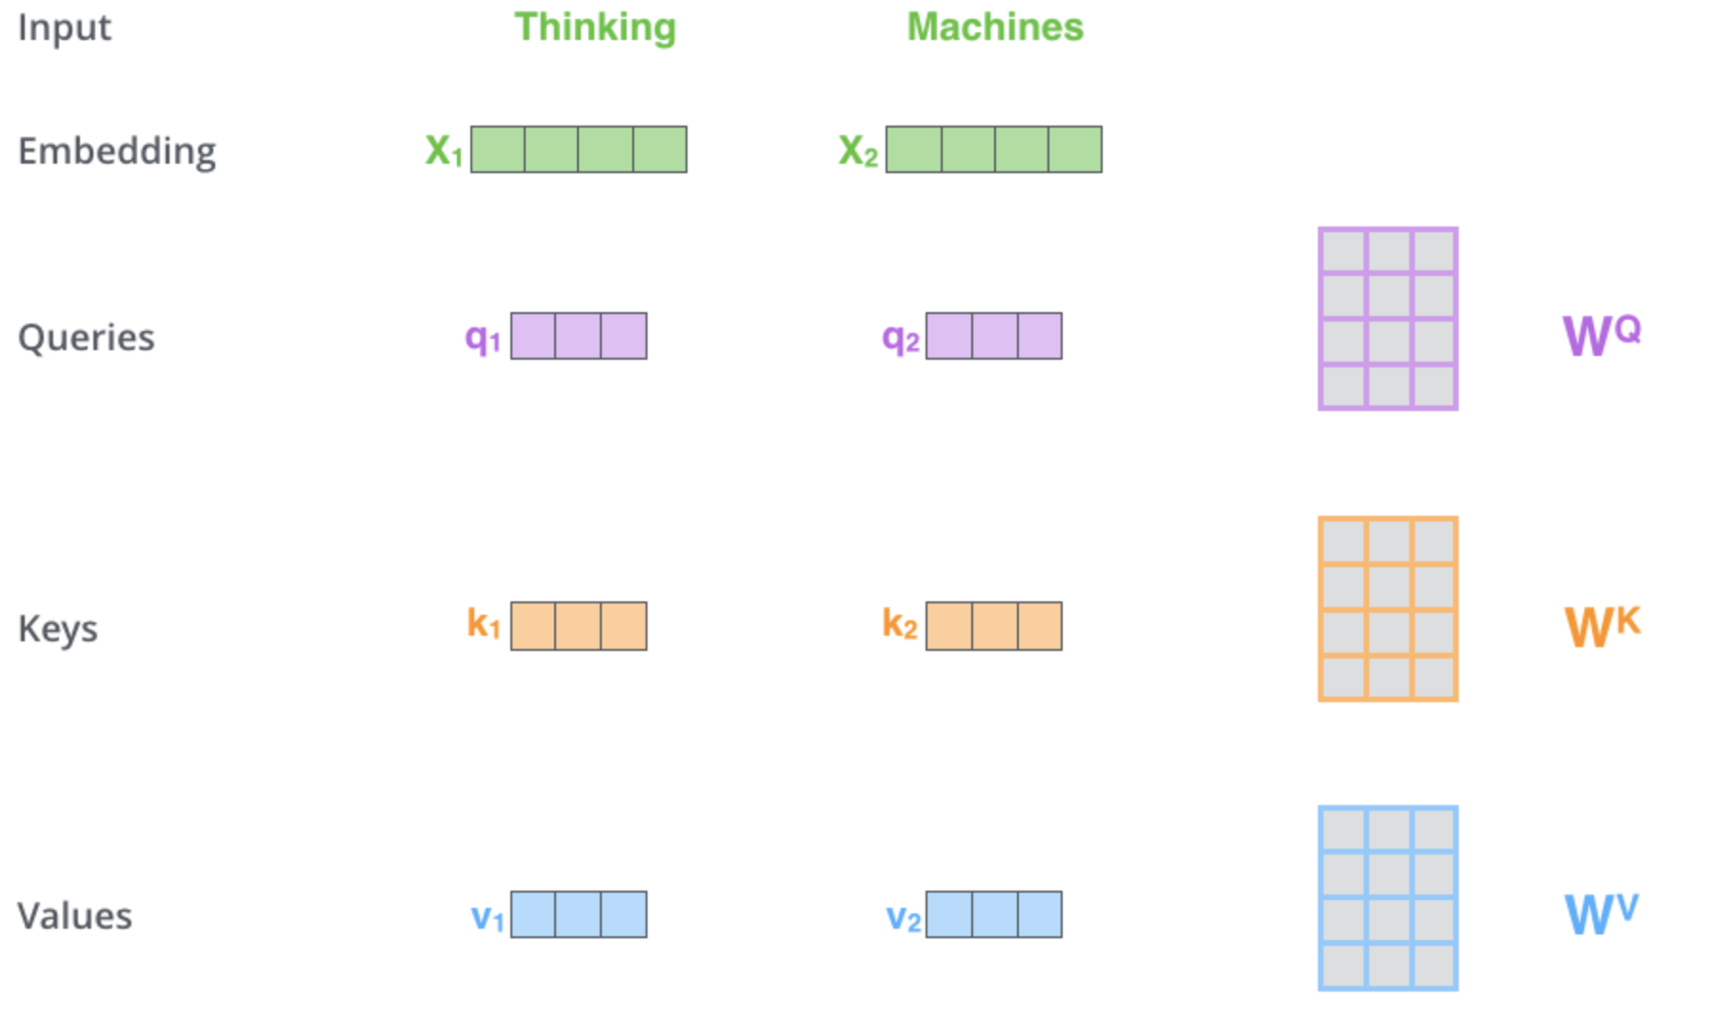
Self Attention: Query – Key – Value
Learned weight matrices
http://jalammar.github.io/illustrated-transformer/

Slide 14
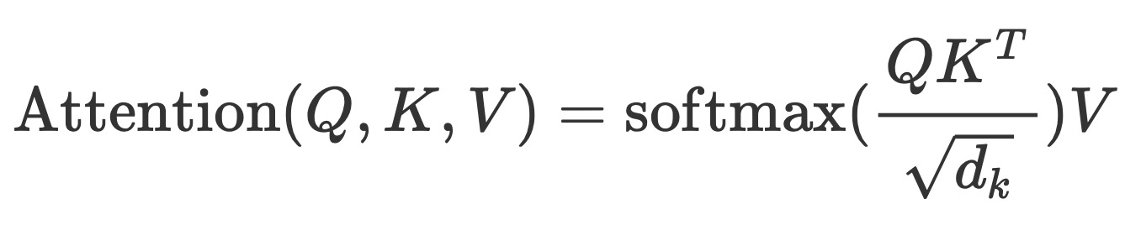
Self Attention: Query – Key – Value
CONTEXT
QUERY: Built from embedded input sequence
KEY: Same as query
VALUE: Same as query
ATTENTION: “relatedness” between pairs of words
CONTEXT: The sequence of context values
Matrix multiply
1. matrix multiply
2. scale
3. softmax
ATTENTION
VALUE
QUERY
KEY

Slide 15
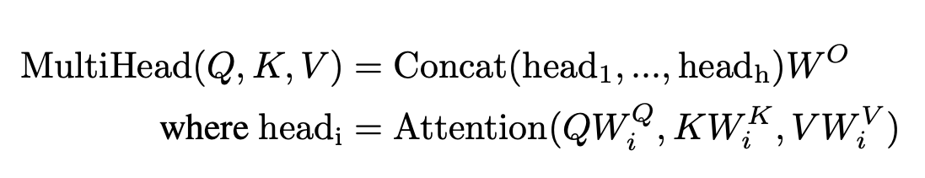
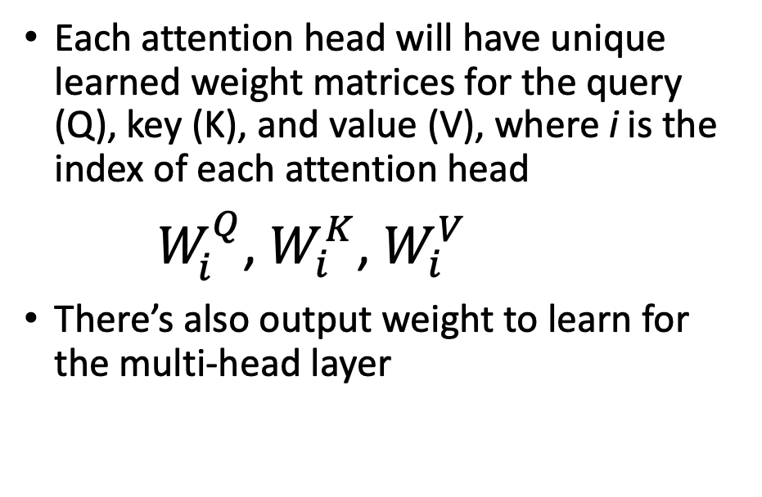
Multi-head Self Attention
CONTEXT
Each attention head will have unique learned weight matrices for the query (Q), key (K), and value (V), where i is the index of each attention head
$W_{i}^{Q}$, $W_{i}^{K}$, $W_{i}^{V}$
There’s also output weight to learn for the multi-head layer
1. matrix multiply
2. scale
3. softmax
1. matrix multiply
2. scale
3. softmax
Matrix multiply
1. matrix multiply
2. scale
3. softmax
ATTENTION
VALUE
QUERY
KEY

Slide 16
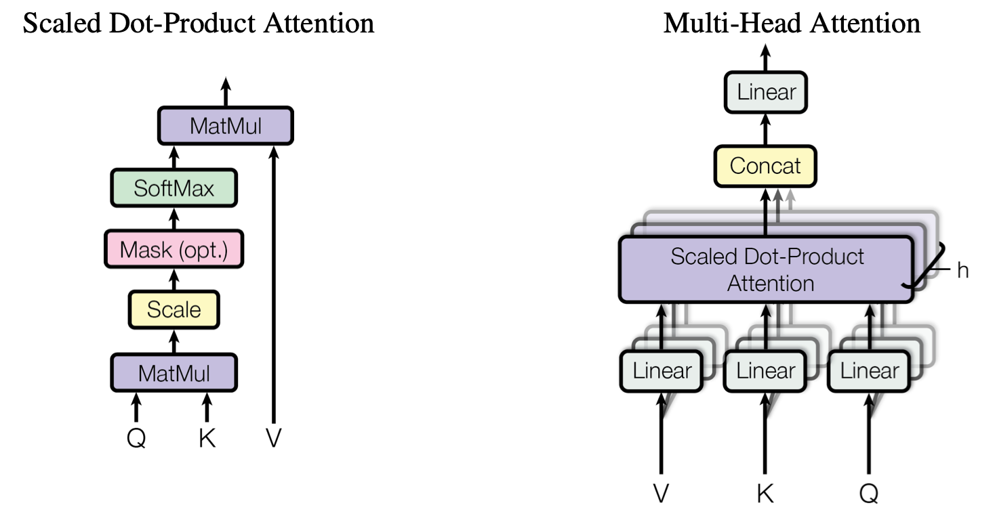
Here’s the figure from the paper

Slide 17
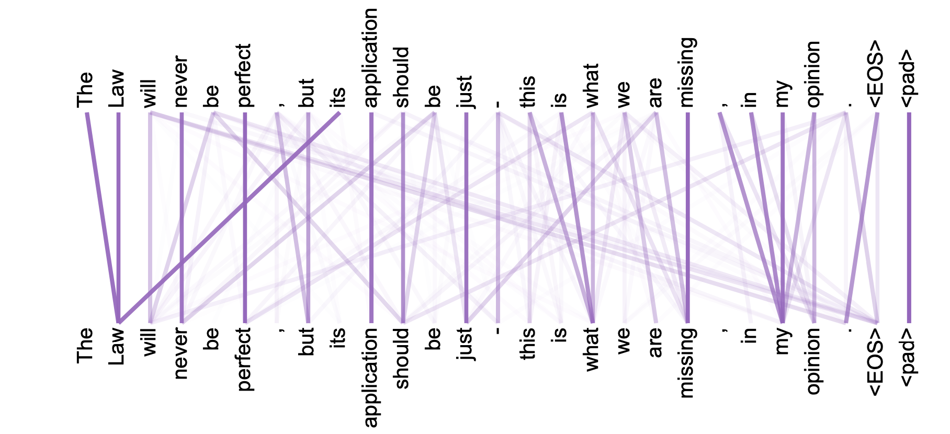
Self-attention: one head, all words

Slide 18
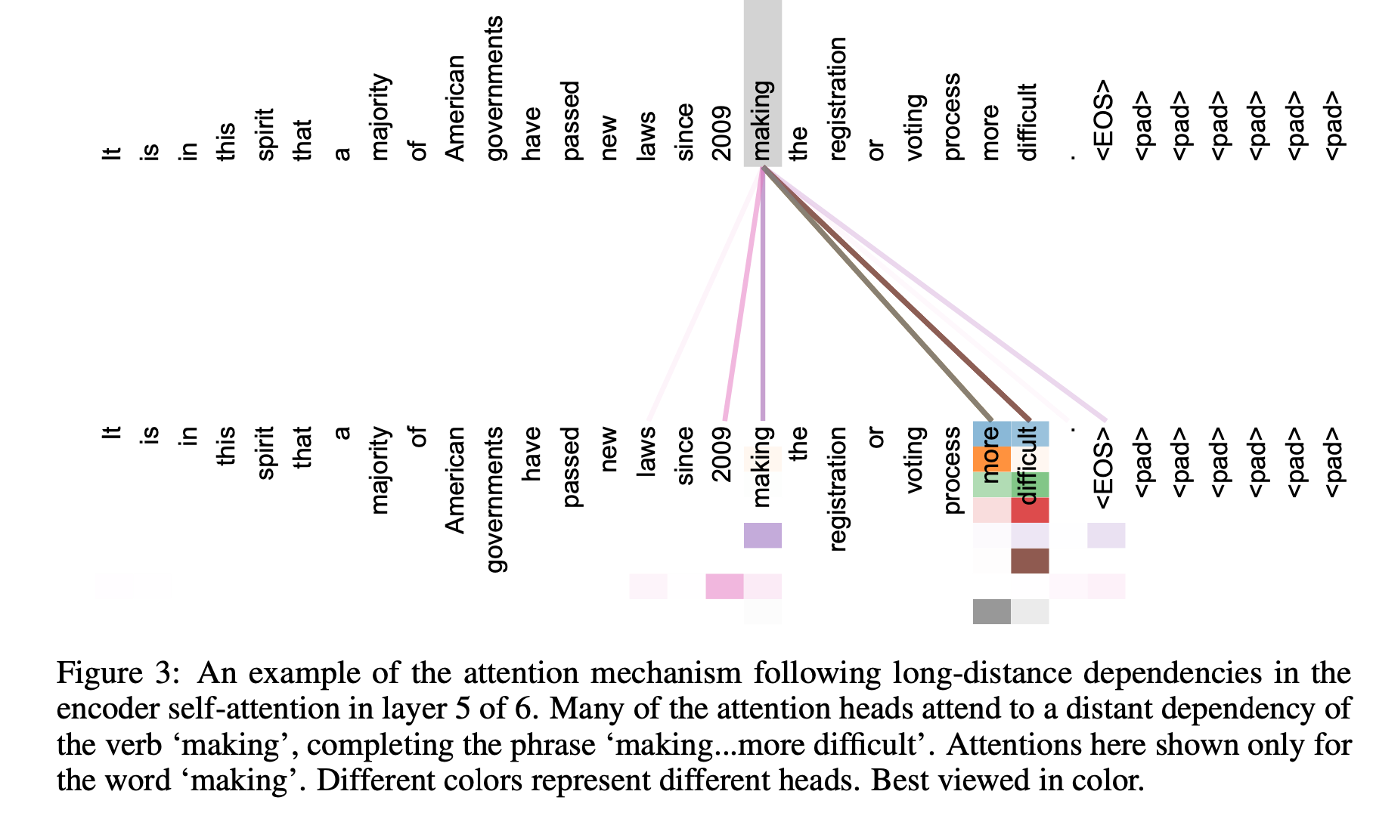
Self attention: Multiple heads, one word

Slide 19
Step-by-step
Two linear layers, with a ReLU in between

Slide 20
Step-by-step
One encoder block
Nx: The number of encoder blocks IN SEQUENCE

Slide 21
Step-by-step
Run the encoder on the ENTIRE input language sequence.
The decoder outputs tokens one-at-a-time, feeding the previous token output into the model to generate the next token.
The next decoder output is conditioned on the ENTIRE sequence of encoder outputs + the previous decoder output.

Slide 22
Step-by-step

Slide 23
Step-by-step

Slide 24

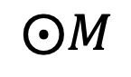
Masked attention
Don’t let the attention ”look ahead” to sequence elements the system hasn’t generated yet
Apply a “mask” matrix with 0 everywhere you’re not allowed to look and 1 everywhere else
Do element-wise multiplication to the value vector
$$⨀M$$

Slide 25
3 variants of attention

Slide 26
That’s the whole model

Slide 27

Transformer encoding: parallelizable
Image from https://jalammar.github.io/illustrated-transformer/

Slide 28

Transformer decoding: autoregressive
Image from https://.github.io/illustrated-transformer/

Slide 29
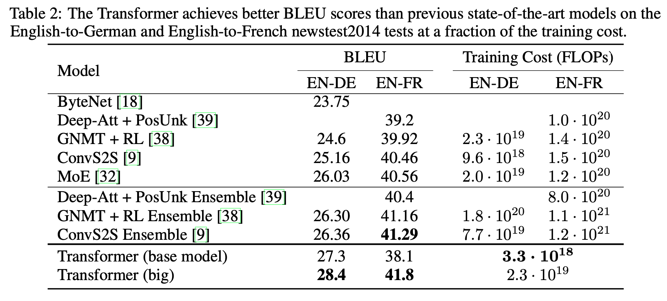
State-of-the-art language translation

Slide 30
OK I’m convinced….attention is great but…
What if I’m doing (single) language modeling instead of translation?
Do I really need this whole encoder-decoder framework?
No. You don’t (more on this in a minute)

Slide 31
Training a good language model is…
Slow
Requires lots of data
Not every task has enough labeled data
Requires lots of computing resources
Not everyone has enough computing resources

Slide 32
Let’s use TRANSFER LEARNING!
Train a general model on some task using a huge dataset for a long time
Fine-tune the trained model on a variety of related “downstream” tasks
Allows re-use of architecture
Allows training on tasks where there is relatively little data

Slide 33
Use half of a Transformer
Get rid of the encoder
Use the decoder as a language model
Note that this is an autoregressive model

Slide 34
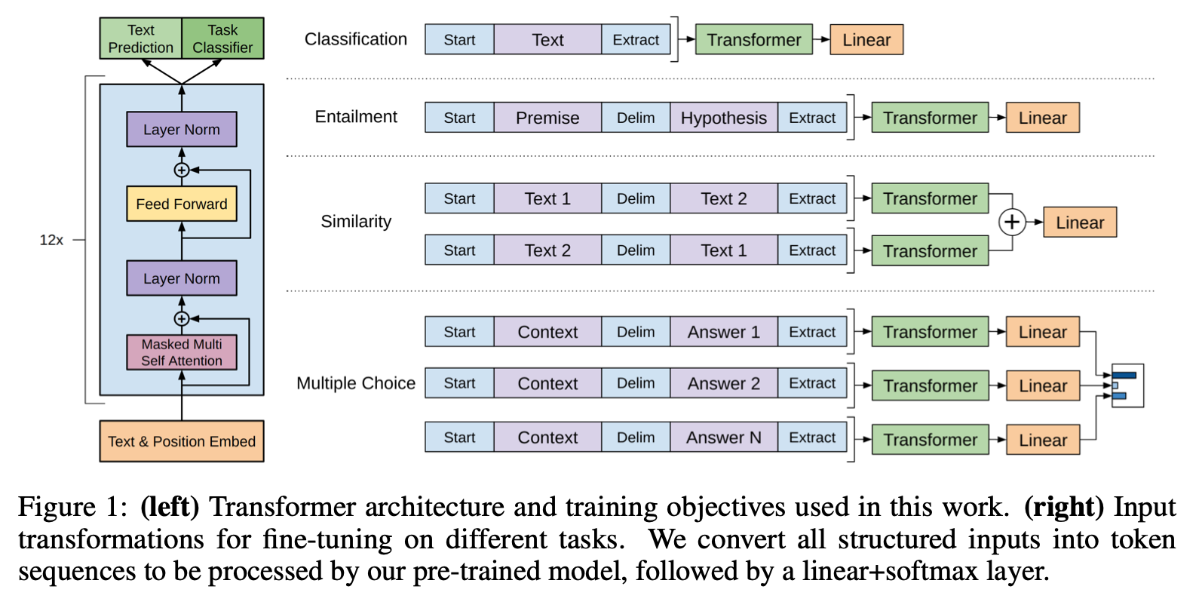
GPT: Generative Pre-Training
https://cdn.openai.com/research-covers/language-unsupervised/language_understanding_paper.pdf

Slide 35
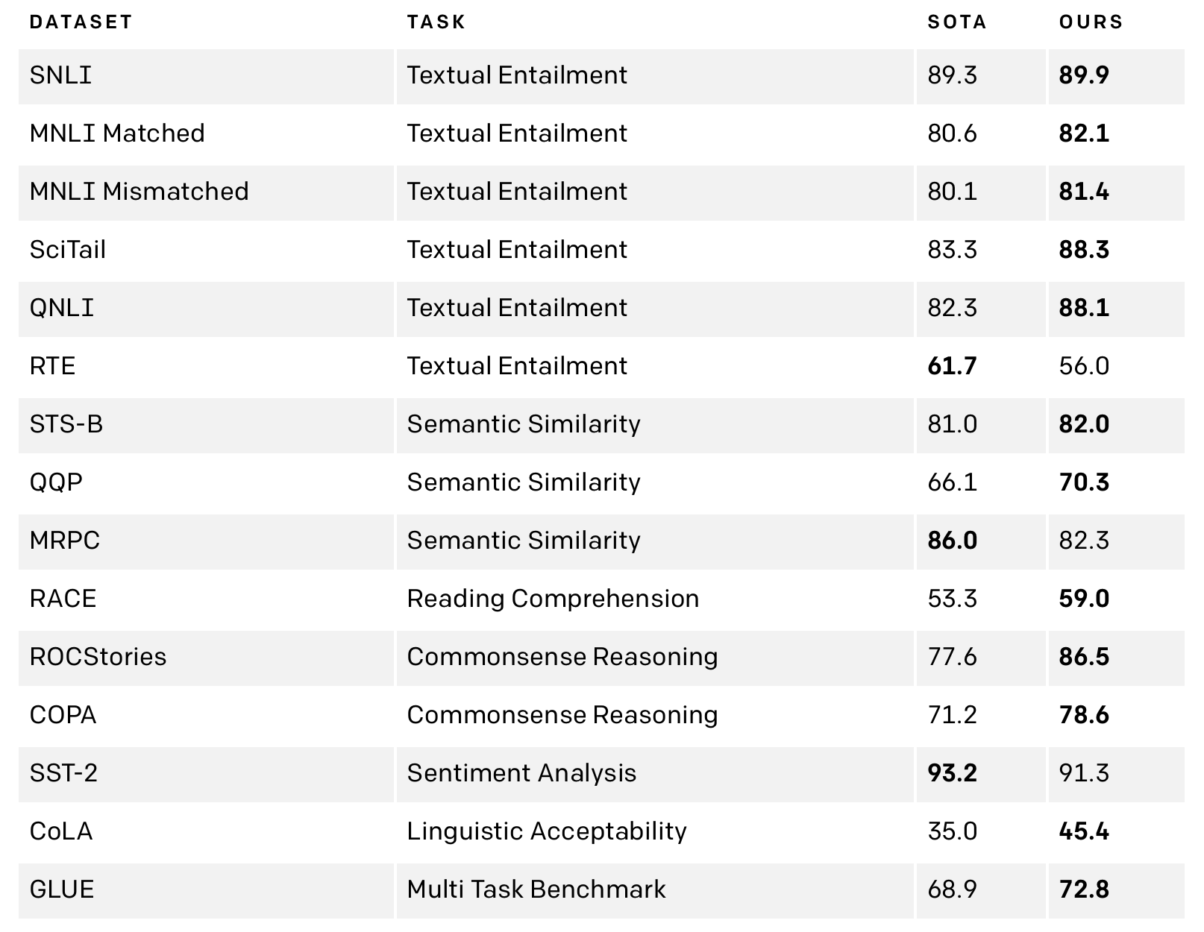
GPT was state of the art in 2018

Slide 36

BERT Bidirectional Encoder Representations from Transformers
Devlin, J., Chang, M. W., Lee, K., & Toutanova, K. (2018). Bert: Pre-training of deep bidirectional transformers for language understanding. arXiv preprint arXiv:1810.04805.
Notes:
https://towardsdatascience.com/bert-explained-state-of-the-art-language-model-for-nlp-f8b21a9b6270

Slide 37
Use the OTHER half of a Transformer
Get rid of the decoder
Use the encoder as a language model

Slide 38
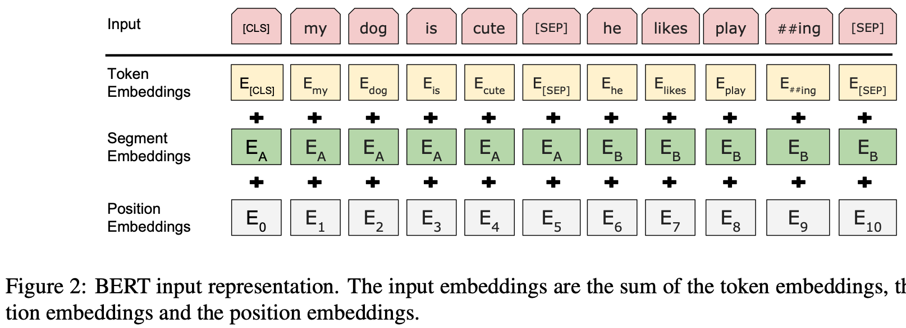
Input encoding to BERT

Slide 39
Masked word prediction training
Randomly cover up a word in a sentence
Original sentence: My dog has fleas.
Training sentences:
[MASK] dog has fleas.
My [MASK] has fleas.
My dog [MASK] fleas.
My dog has [MASK].

Slide 40
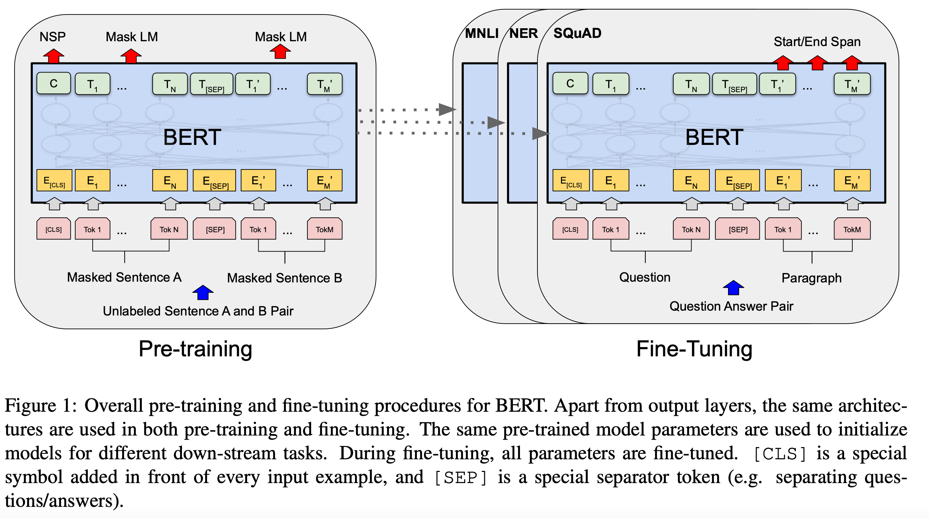
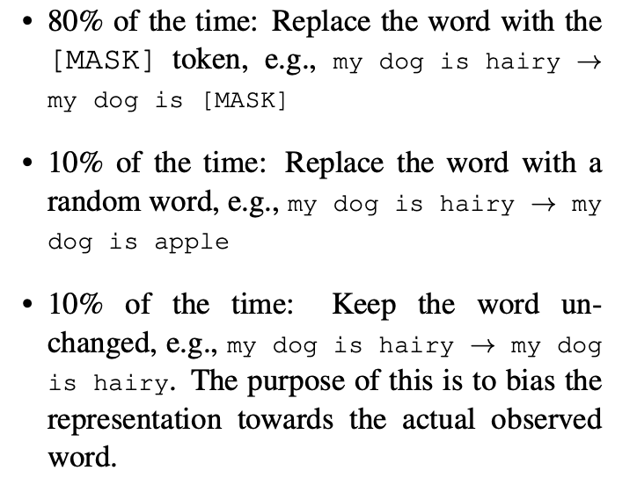
Model learns to expect [MASK]. Here’s the fix.

Slide 42
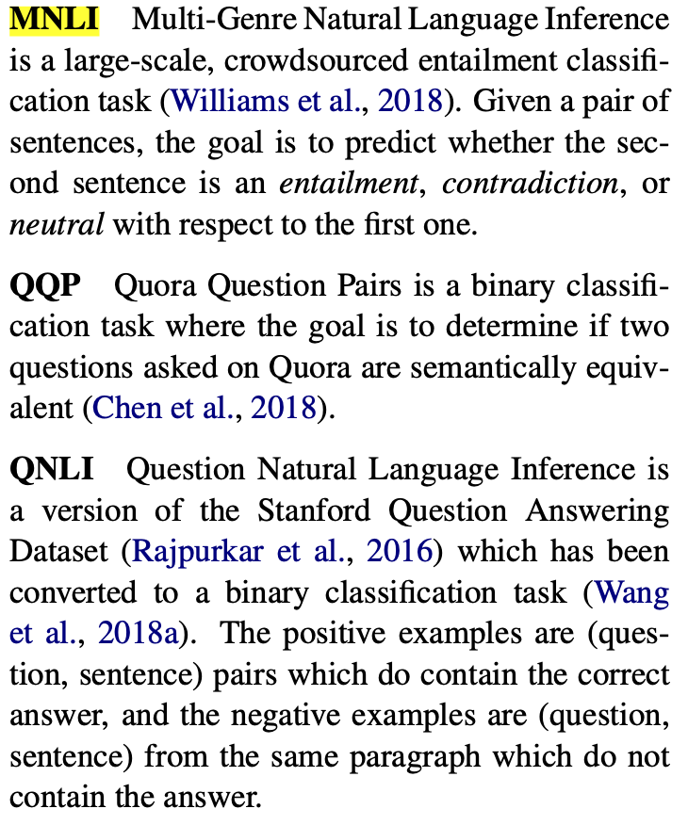
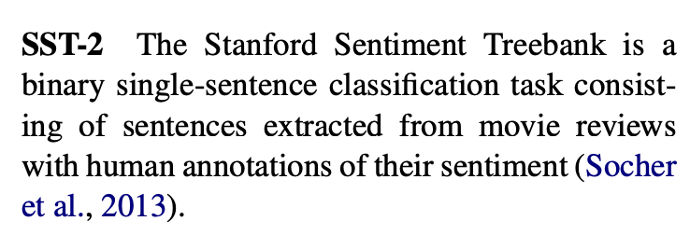
Language Tasks

Slide 43
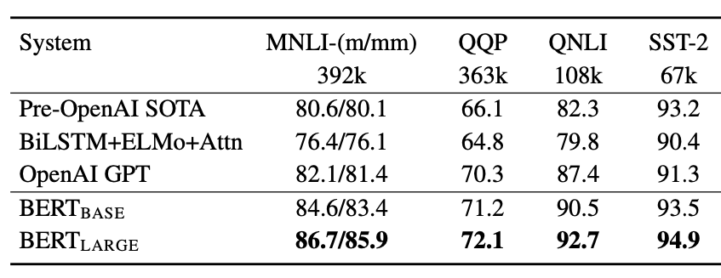
General Language Understanding Evaluation

Slide 44
Bigger is better?
OpenAI: GPT3: 175 billion parameters
Brown, T. B., Mann, B., Ryder, N., Subbiah, M., Kaplan, J., Dhariwal, P., ... & Agarwal, S. (2020). Language models are few-shot learners. arXiv preprint arXiv:2005.14165.
Microsoft: Turing-NLG: 20 billion parameters
(February 2020) https://www.microsoft.com/en-us/research/blog/turing-nlg-a-17-billion-parameter-language-model-by-microsoft/
NVIDIA:Megatron: 8 billion
Shoeybi, M., Patwary, M., Puri, R., LeGresley, P., Casper, J., & Catanzaro, B. (2019). Megatron-lm: Training multi-billion parameter language models using gpu model parallelism. arXiv preprint arXiv:1909.08053.
OpenAI: GPT-2: 1.5 billion parameters
Radford, A., Wu, J., Child, R., Luan, D., Amodei, D., & Sutskever, I. (2019). Language models are unsupervised multitask learners. OpenAI blog, 1(8), 9.
Google: BERT (Transformer): 300 million parameters
Devlin, J., Chang, M. W., Lee, K., & Toutanova, K. (2018). Bert: Pre-training of deep bidirectional transformers for language understanding. arXiv preprint arXiv:1810.04805.
OpenAI: GPT (Transformer): 100 million parameters
Radford, A., Narasimhan, K., Salimans, T., & Sutskever, I. (2018). Improving language understanding by generative pre-training.
Google: Seq2Seq LSTM: 65 million parameters
Britz, D., Goldie, A., Luong, M. T., & Le, Q. (2017). Massive exploration of neural machine translation architectures. arXiv preprint arXiv:1703.03906.

Slide 45
Bigger is better?
Human Brain: 10^15 connections
https://www.nature.com/articles/d41586-019-02208-0
OpenAI: GPT3: 175 billion parameters
Brown, T. B., Mann, B., Ryder, N., Subbiah, M., Kaplan, J., Dhariwal, P., ... & Agarwal, S. (2020). Language models are few-shot learners. arXiv preprint arXiv:2005.14165.
Microsoft: Turing-NLG: 20 billion parameters
(February 2020) https://www.microsoft.com/en-us/research/blog/turing-nlg-a-17-billion-parameter-language-model-by-microsoft/
NVIDIA:Megatron: 8 billion
Shoeybi, M., Patwary, M., Puri, R., LeGresley, P., Casper, J., & Catanzaro, B. (2019). Megatron-lm: Training multi-billion parameter language models using gpu model parallelism. arXiv preprint arXiv:1909.08053.
OpenAI: GPT-2: 1.5 billion parameters
Radford, A., Wu, J., Child, R., Luan, D., Amodei, D., & Sutskever, I. (2019). Language models are unsupervised multitask learners. OpenAI blog, 1(8), 9.
Google: BERT (Transformer): 300 million parameters
Devlin, J., Chang, M. W., Lee, K., & Toutanova, K. (2018). Bert: Pre-training of deep bidirectional transformers for language understanding. arXiv preprint arXiv:1810.04805.
OpenAI: GPT (Transformer): 100 million parameters
Radford, A., Narasimhan, K., Salimans, T., & Sutskever, I. (2018). Improving language understanding by generative pre-training.
Google: Seq2Seq LSTM: 65 million parameters
Britz, D., Goldie, A., Luong, M. T., & Le, Q. (2017). Massive exploration of neural machine translation architectures. arXiv preprint arXiv:1703.03906.

